Slide 1
ME 224 Course Project
DIAL-A-LEVEL
06-05-2024
BY
Bhawana
220103030
Kashish kanodia
220103062
Department of Mechanical Engineering
Indian Institute of Technology Guwahati

Slide 2
Motivation and Application
MOTIVATION
Dial-A-Level is a tool designed to detect changes in relative height, unevenness or runout that cannot be discerned with the naked eye.
It is designed by using a compliant mechanism.
The aim of this is to convert a very small vertical movement to a very large swiping movement which can be measured on the dial.
APPLICATION
Workpiece alignment in various machines including, milling machines, lathe machines, grinding machines, and EDM.
Dial gauge indicators find significant application in automotive disc brakes where they are used to check lateral run-out. Dial indicators are used to calibrate the machines in the workshop.
They can measure minute height differences on a surface plate with ease.

Slide 3
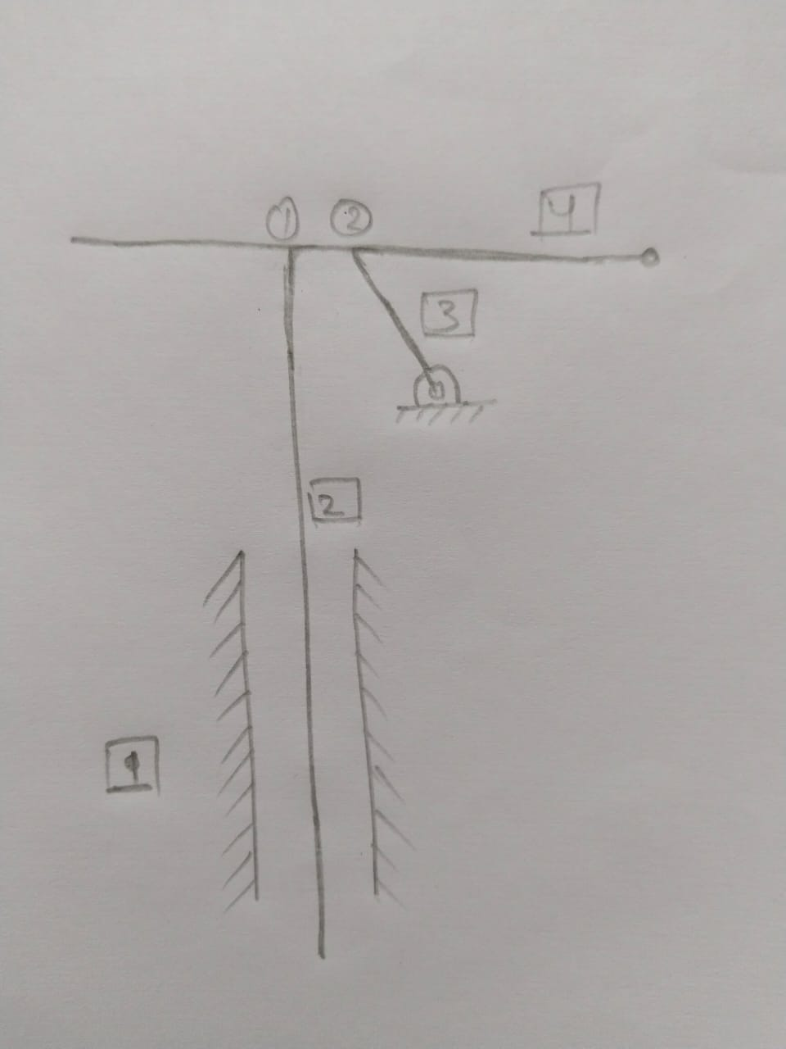
Kinematic Analysis
Points 1 and 2 are part of the same body but here they are working as rotary joints.
Number of links = n = 4
Number of one degree joints = p1 = 4
Number of two degree joints = p2 = 0
DOF = 3(n-1)-2*p1-p2
DOF= 3(4-1) – 2(4)-0
DOF = 1

Slide 4
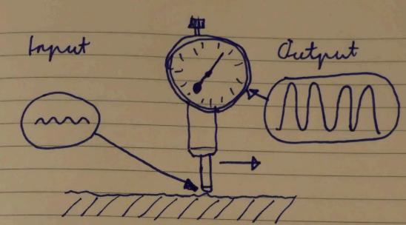
Working Principle
It uses the reverse principle of archimedes lever.
Here we actuate the heavy end and get a lot of movement on the other side (dial needle).
Plastic used is thin enough to be able to actuate and using this device requires only a slight force to bend the plastic.
This plastic moves the needle and hence height changes can be measured.

Slide 5
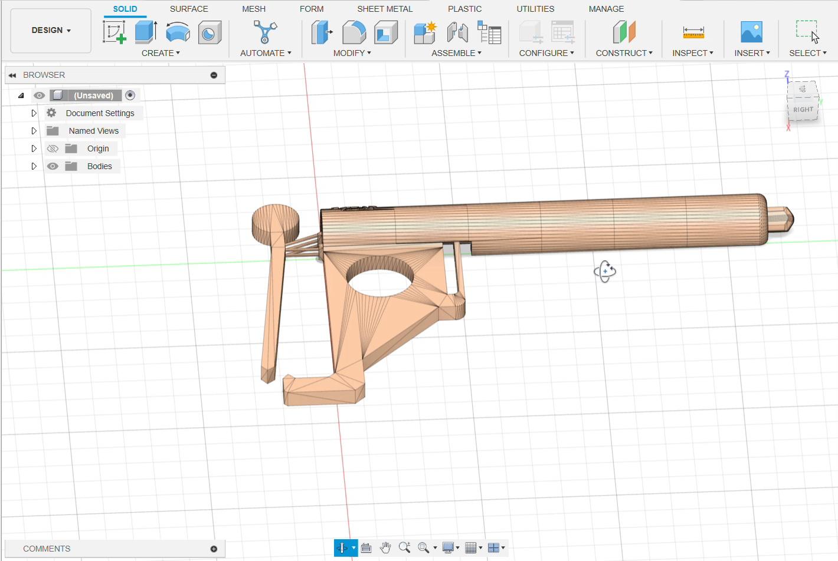
Computer Aided Design
Link to CAD Model : https://a360.co/4aRDSQc

Slide 6
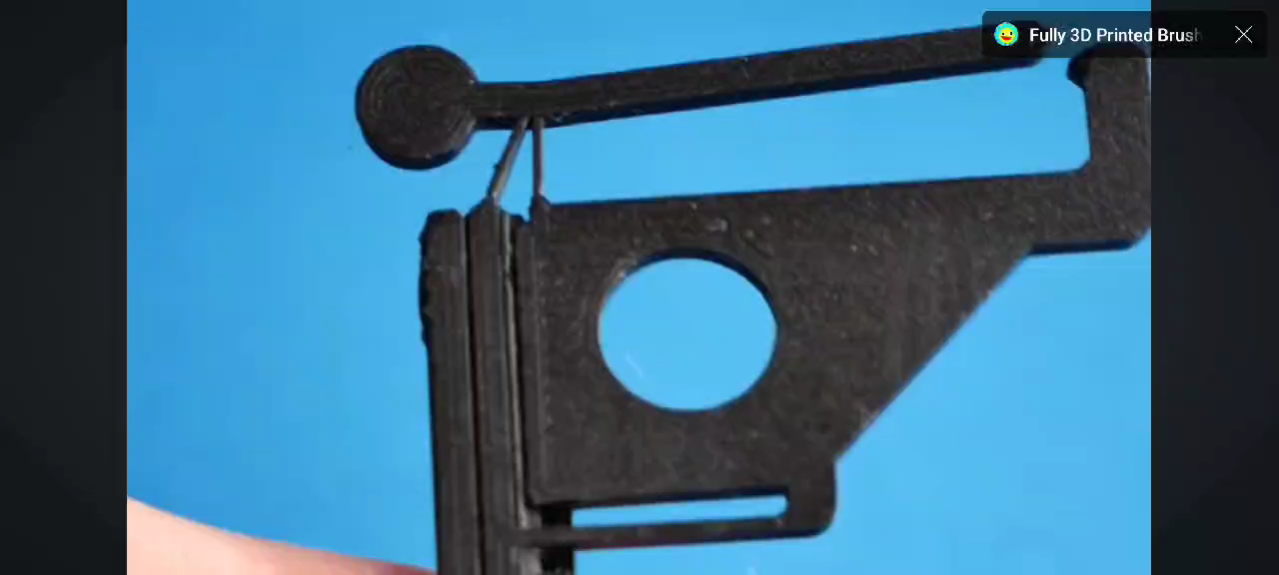
Working

Slide 7
Fabrication Details
PREPARE A DETAILED CAD MODEL USING FUSION 360.
FUSION FILE OF 3D MODEL IS THEN CONVERTED TO STL FILE AND THEN SLICED USING ULTIMAKER.
3D PRINTING IS DONE USING PLA AS MATERIAL .
15% INFILL WAS USED IN MAKING THE MODEL.

Slide 8
Conclusions
Why is this better than conventional dial indicators?
A dial indicator uses a clever arrangement of gears and springs to indicate a difference in height that the user cannot discern with the naked eye.
Designing them with conventional methods lead to undesirably large print and this results in backlash which is the enemy of precision.
Print-in-place adds even more backlash. Hence our model, Dial-A-Level, comes in use.

Slide 9
THANKYOU
Thanks for watching. Keep Learning, Keep innovating.

